Slide 1
Revenue optimization
Vaijeyanthi Venkateswaran

Slide 2
Design layout
Re-train models with reduced features
Data integration
Data cleansing
Normalization
Training and testing ML models
Feature importance analysis
Balancing the data
Re-train the ML models
Sort clients with high propensity and high expected revenue

Slide 3
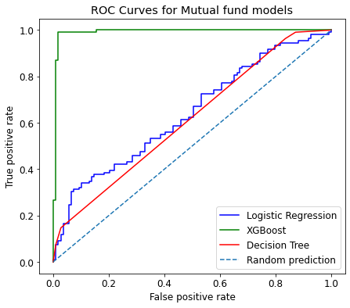
Comparison of models-Mutual funds
XGBoost classifier has better lift compared to other models

Slide 4
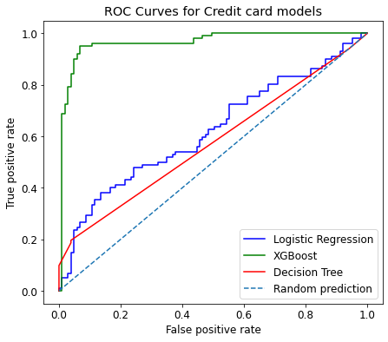
Comparison of models-Credit card
XGBoost classifier has better lift compared to other models

Slide 5
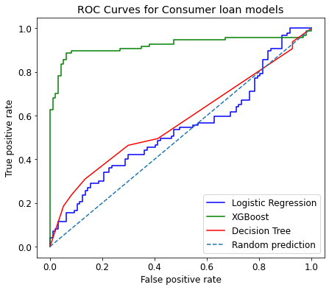
Comparison of models-Consumer loan
XGBoost classifier has better lift compared to other models

Slide 6
Comparison of models- Average F1 score

Slide 7
Appendix

Slide 8
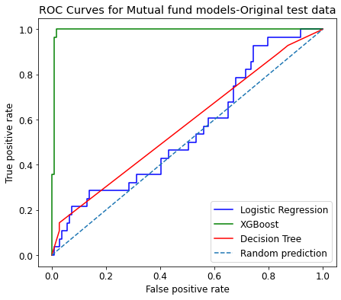
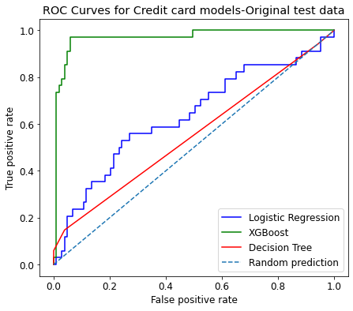
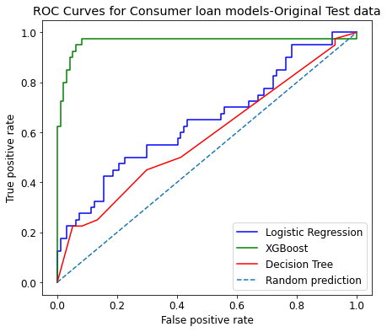
Evaluating models with original test data
Note:
XGBoost classifier has better lift compared to other models.
Using original test data instead of balanced (oversampled) data did not drastically change average F1 scores or the lift in ROC curves.

Slide 9
Comparison of average F1 scores on imbalanced and balanced data
Propensity model | Logistic regression |  | Decision tree |  | XGBoost
 | Imbalanced data | Balanced data | Imbalanced data | Balanced data | Imbalanced data | Balanced data
Mutual Fund | 0.43 | 0.61 | 0.58 | 0.46 | 0.53 | 0.92
Credit Card | 0.54 | 0.61 | 0.54 | 0.51 | 0.51 | 0.85
Consumer loan | 0.56 | 0.62 | 0.61 | 0.54 | 0.55 | 0.82

